Slide 1

W I t n e s s l o v e b y N F T

Slide 2


How to enjoy Witness
We are a community who witness your love by NFT
01
02
03
«
«
Connect Wallet
Sign up & bind
Enjoy Witness!
Connect your MetaMask wallet
Register and bind your lover's address
Now you can try to play to earn your NFT!

Slide 3
Mission of us
Create a platform for couples to record love, and encourage more people to participate by giving couple NFT avatars. Couples can punch in by playing Web3 games in order to get avatars.
More importantly, we let couples participate in the process of minting NFT avatars by integrating the wallet address elements
In the future, couples are allowed to put their NFT avatars on the Opensea platform. Besides, enterprises can sell their products (such as diamond rings or necklace……) on Witness. We will give couples who bought products on witness exclusive NFT of the product.

Slide 4


1. PLAY

Slide 5
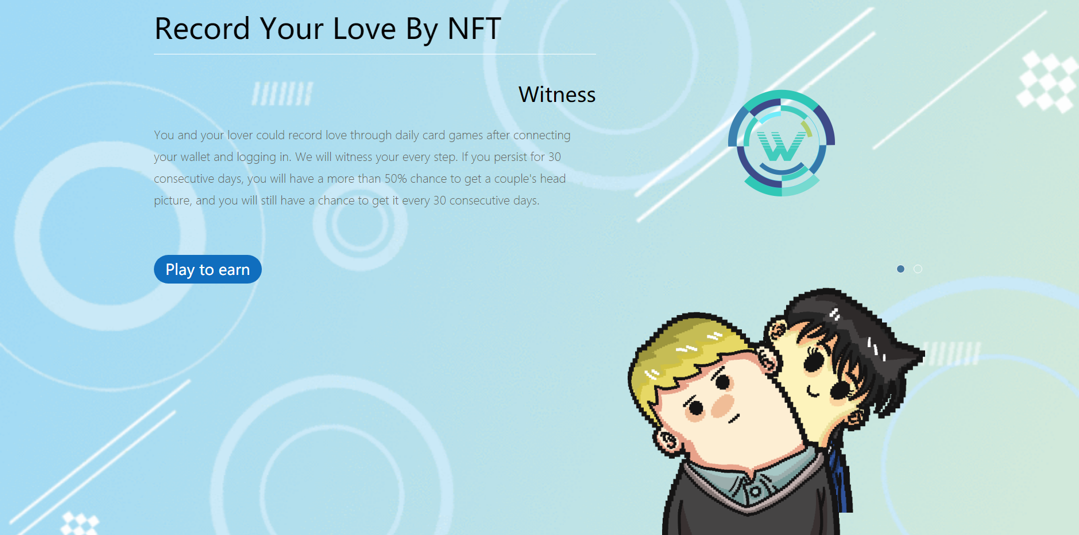
Web-Play

Slide 6
Connect Wallet
Play to earn
METADATA
0x AE16D9 E58C63 CF274E 30B06CB7C9C5367C3229C9
R229
G140
B99
TRANSFORMED
DATA
0x AE16D9 E58C63 CF274E 30B06CB7C9C5367C3229C9
Decoding the address, to obtain the corresponding RGB value, so as to give color to the NFT
Power of Witness

Slide 7


Hair
Shirt
Coat
Minting Avatars......

Slide 8


0x AE16D9 E58C63 CF274E 30B06CB7C9C5367C3229C9
Success!

Slide 9


Something cool~
If your address is special enough, you can get a rare NFT like the above

Slide 10
Gen 1.0
Gen 2.0

Slide 11





Future
NFT show
……

Slide 12
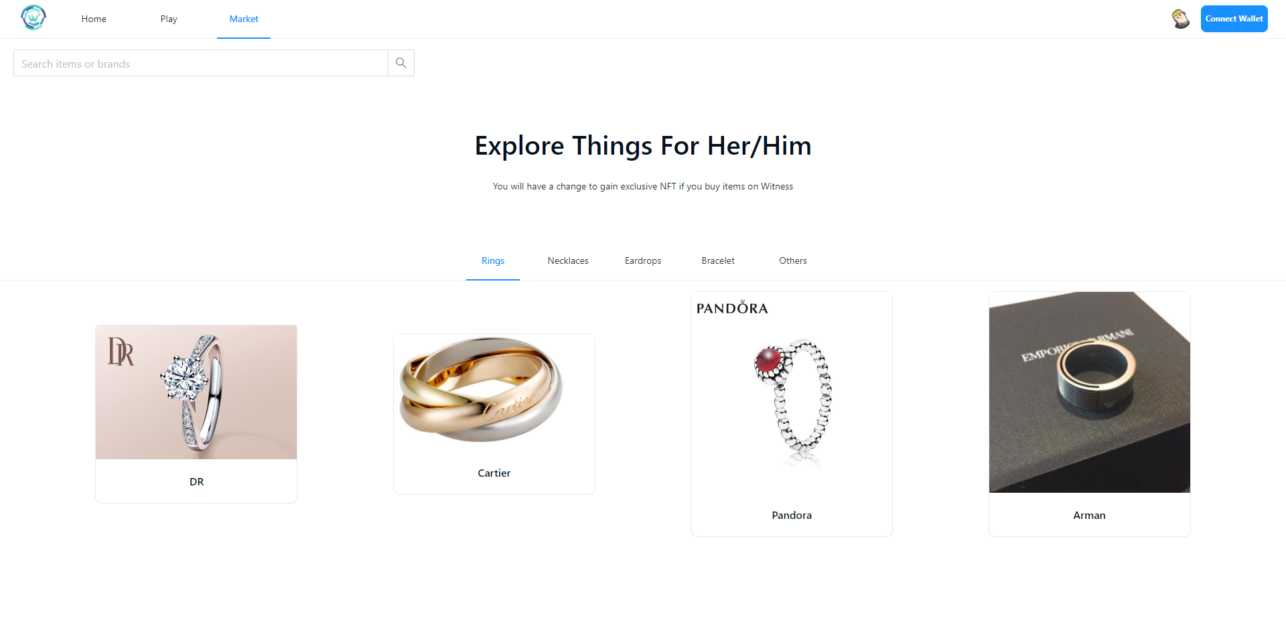
Web-Market

Slide 13



2. BUY
……
You can buy gifts on Witness for your lover. If you place an order on Witness, you will have a chance to get exclusive NFT

Slide 14
3. SELL
If you want to sell your NFT Avatars, Witness will help you put your Avatars on the OpenSea

Slide 15
Witness
Thanks for enjoying Witness

